Slide 1
Text Summarization
Maximizing Productivity while Reducing Reading time
Isha Negi
Sanskriti Shivhare
Notes:
Text summarization is becoming increasingly important in today's world due to the sheer volume of information that we encounter daily.
With the vast amount of information available on the internet, it can be challenging to find and extract the most relevant and useful information from a given document.
Text summarization helps to overcome this challenge by providing a quick and efficient way of understanding the key ideas and concepts contained in a large document.
Text summarization is an essential tool for journalists, researchers, students, and anyone else who needs to quickly digest a large amount of information.
Slide Title: Types of Text Summarization

Slide 2

What is Text Summarization?
Notes:
Text summarization is a process of creating a concise and coherent summary of a large document while retaining the key information and overall meaning.
This technology helps to identify the critical and interesting parts of the document that are relevant to the user's interests, thereby increasing productivity and reducing time spent on each article or piece of information.
Text summarization has the potential to revolutionize the way we consume information by providing us with quick and efficient access to relevant content.
The main objective of this project is to produce a brief summary of news articles that accurately represents the original text's content.

Slide 3
Approaches for Text Summarization
Extractive Summarization
Abstractive Summarization
Selects important sentences or phrases from the original text and concatenates them into a shorter summary.
Does not generate new text.
May not be as accurate or fluent.
It is typically easier to implement and faster
Generates a summary that is different from the original text.
May paraphrase, summarize, or even rewrite the original text.
Can be more accurate and fluent
It is typically more difficult to implement and slower.
Notes:
There are two main types of text summarization: extractive and abstractive.
Extractive summarization involves selecting the most critical sentences or phrases from the original text and combining them to form a summary.
Abstractive summarization involves creating a summary by generating new sentences that convey the key information from the original text.
Extractive summarization is generally considered to be more straightforward and more effective than abstractive summarization, but abstractive summarization has the potential to produce more human-like summaries.
Extractive summarization:
Extractive summarization is a relatively simple technique that can be implemented using a variety of methods. One common approach is to use a statistical method to rank the sentences in a document based on their importance. The most important sentences are then selected and concatenated to form a summary.
Extractive summarization is typically easier to implement than abstractive summarization, and it can be faster. However, extractive summaries may not be as accurate or fluent as abstractive summaries. This is because extractive summaries are limited to the words and phrases that are actually present in the original text. If the original text is poorly written or contains jargon, an extractive summary may not be able to accurately capture the meaning of the text.
Abstractive summarization:
Abstractive summarization is a more complex technique that requires a deep understanding of the meaning of the original text. Abstractive summarizers typically use natural language processing techniques to identify the key ideas in a document and then generate a summary that expresses those ideas in a new way.
Abstractive summarization can be more accurate and fluent than extractive summarization, but it is typically more difficult to implement and slower. This is because abstractive summarizers need to be able to understand the meaning of the original text, which can be a challenging task.

Slide 4
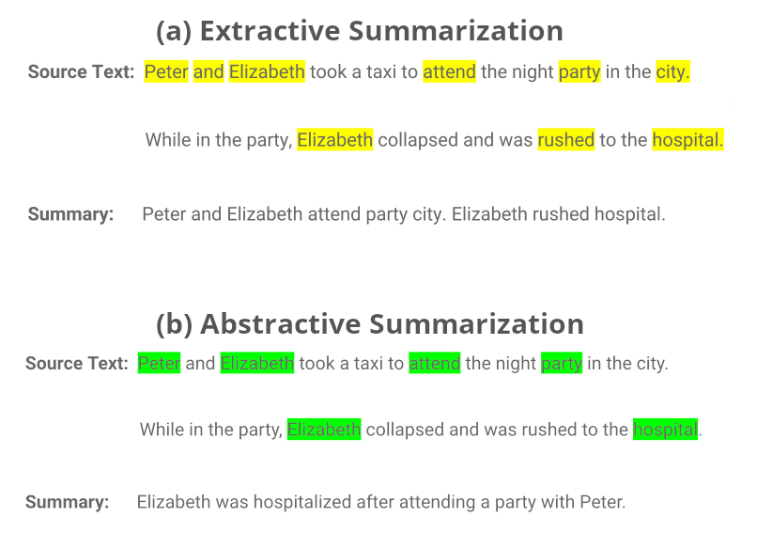
Extractive Summarization
Abstractive Summarization
Notes:
This is an example of the two type of text summarization technique.

Slide 5
Project Lifecycle
3.
Define and Train the Model
1.
Load the Dataset
5.
Evaluating summaries
2.
Data Cleaning and Preprocessing
4.
Generating summaries
Notes:
1. Loading the dataset
The next step is to load the dataset. The dataset is a collection of news articles and corresponding summaries. The articles are in the form of text files, and the summaries are in the form of csv files.
Load the downloaded dataset files into memory and extract the article and summary pairs.
Tokenize the text using the punkt tokenizer.
Remove any examples where the article or summary are empty.
Explore and visualize the data.
2. Preprocessing the data
The data needs to be preprocessed before it can be used for summarization. This includes tasks such as tokenizing the text, removing stop words, and stemming the words.
Examine the length distribution of the articles and summaries.
Plot histograms of the length distribution.
Compute and display summary statistics (mean, median, standard deviation) of the length distribution.
Prepare the data for training.
3. Training the summarizer
The summarizer is a machine learning model that is trained to generate summaries from text. The summarizer is trained on a dataset of news articles and corresponding summaries.
Load the saved model weights.
Tokenize and preprocess new articles.
Use the model to generate summaries for the new articles.
Print the generated summaries.
4. Generating summaries
Once the summarizer is trained, it can be used to generate summaries from new text. To do this, the summarizer is given a piece of text, and it generates a summary of that text.
5. Evaluating the summaries
The quality of the summaries can be evaluated using a variety of metrics. These metrics measure the accuracy, fluency, and informativeness of the summaries.

Slide 6

Data Overview
The CNN / Daily Mail Dataset is a large-scale dataset of news articles and corresponding summaries written by journalists from two major news websites: CNN and DailyMail.
The dataset is large and diverse, with over 300k unique news articles by CNN and DailyMail.
The articles cover a wide range of topics, including politics, sports, entertainment, technology, and more.
Notes:
This dataset is a popular choice for text summarization tasks due to its large size and diverse range of topics.
It provides a wide range of articles from two major news websites, making it ideal for training and testing models on real-world data.
The dataset also includes human-written summaries, which can be used as a reference for evaluating the performance of the model-generated summaries.
However, the dataset is not without its limitations, as the summaries are relatively short and may not capture all of the important details in the original articles.

Slide 7
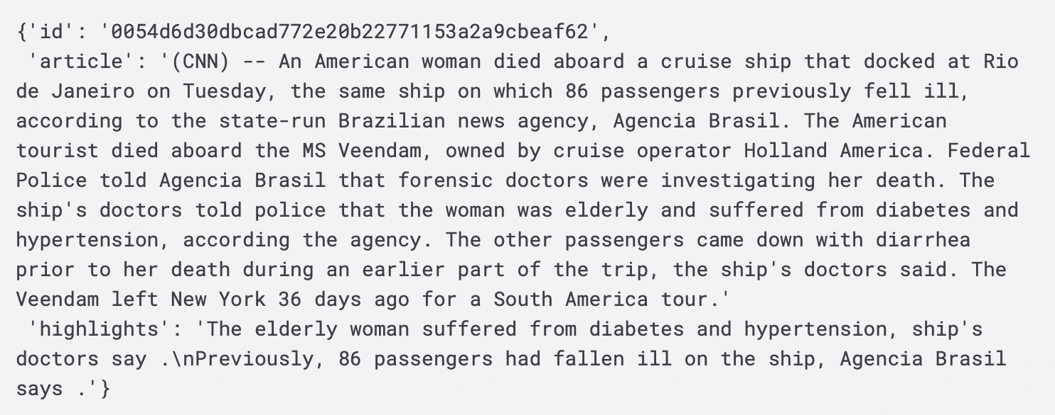
Data Fields
Article ID (String)
A unique identifier for each article in the dataset. It is a string containing the heximal formatted SHA1 hash of the url where the story was retrieved from.
Article Text (String)
The main body of the news article, which contains the full text of the article.
Article Highlights (String)
Human-generated summaries of the article, usually a few sentences long, highlighting the key points or main ideas of the article.

Slide 8
Data Cleaning and Data Preprocessing
Data Cleaning
Remove irrelevant data like images, videos, and ads
Remove HTML tags, special characters, and punctuation marks
Convert text to lowercase and remove stop words
Tokenize the text by splitting it into individual words or tokens.
Data Preprocessing
Data preprocessing is the next step after data cleaning.
Word embeddings are used to represent text as a vector of numbers.
Sequence padding is performed to ensure all input data has the same length, necessary for deep learning models.
The data is split into training, validation, and testing sets.
Notes:
Data cleaning and preprocessing are crucial steps in any NLP task, including text summarization. In this project, we use the CNN/Daily Mail dataset to train and evaluate our text summarization models.
In data cleaning, we remove any irrelevant data, such as images, videos, or advertisements, from the dataset. Then, we remove any HTML tags, special characters, or punctuation marks from the text. We also convert all the text to lowercase and remove stop words, which are common words that do not add much meaning to the text. Finally, we perform tokenization, which is the process of splitting the text into individual words or tokens.
In data preprocessing, we convert the text into a format that can be fed into our machine learning models. We use word embeddings to represent the text, where each word is represented as a vector of numbers. We also pad the sequences to ensure that all the input data has the same length, which is required for deep learning models. Finally, we split the data into training, validation, and testing sets.
Data cleaning and preprocessing are critical for achieving good results in text summarization. By removing irrelevant data and converting the text into a format that can be processed by our models, we can train more accurate and efficient models.

Slide 9
Training and Modelling
Recurrent Neural Network - LSTM
Latent Semantic Analysis
Transformer based - T5
Transformer based -BERT
Notes:
LSTM (Long Short-Term Memory) is a type of recurrent neural network (RNN) architecture used in deep learning. It is particularly useful for processing sequential data, such as text data, due to its ability to remember past information and selectively forget or retain it as needed. LSTM networks consist of memory cells and gates that control the flow of information into and out of the cells.
LSTM is a type of recurrent neural network (RNN) that is well-suited for text summarization. It is able to learn long-range dependencies between words in a sentence, which is important for summarizing the main points of a document. However, LSTM models can be computationally expensive to train and prone to overfitting.
LSA is a statistical method that uses a mathematical technique called singular value decomposition (SVD) to identify latent semantic relationships between words in a document. LSA can be used to create a summary of a document by identifying the most important words and phrases. However, LSA models can be less accurate than other text summarization models, especially when the documents are long or complex.
Transformer based T5 and transformer based BERT are both neural network models that have been shown to be very effective for text summarization. Transformer based models are able to learn long-range dependencies between words in a sentence, and they are also able to generalize to new data very well. Transformer based T5 and transformer based BERT have both been shown to outperform LSTM and LSA models on the CNN/Daily Mail dataset.

Slide 10
Generating Summaries
ORIGINAL TEXT
associated press published est october updated est october bishop fargo catholic diocese north dakota exposed potentially hundred church member fargo grand fork jamestown hepatitis virus late september early october state health department issued advisory exposure anyone attended five church took communion bishop john folda pictured fargo catholic diocese north dakota exposed potentially hundred church member fargo grand fork jamestown hepatitis state immunization program manager molly howell say risk low official feel important alert people possible exposure diocese announced monday bishop john folda taking time diagnosed hepatitis diocese say contracted infection contaminated food attending conference newly ordained bishop italy last month symptom hepatitis include fever tiredness loss appetite nausea abdominal discomfort fargo catholic diocese north dakota pictured bishop located
MODEL GENERATED SUMMARY
bishop fargo catholic diocese north dakota exposed potentially hundred church member fargo grand fork jamestown hepatitis virus late september early october state health department issued advisory exposure anyone attended five church took communion. bishop john folda taking time diagnosed hepatitis diocese say contracted infection contaminated food attending conference newly ordained bishop italy last month symptom hepatitis include fever tiredness loss appetite nausea abdominal discomfort fargo catholic diocese say exposed
HUMAN-WRITTEN SUMMARY
bishop john folda north dakota taking time diagnosed contracted infection contaminated food italy church member fargo grand fork jamestown could exposed

Slide 11
Evaluating Summaries
After training our LSTM and T5 text summarization models, we evaluated the quality of the summaries generated by these models.
For the LSTM model, we achieved a ROUGE score:
ROUGE-1: 0.7118 (measures the overlap of unigrams)
For the T5 model, we achieved the following ROUGE scores:
ROUGE-1: 0.826087(measures the overlap of unigrams)
ROUGE-2: 0.790123 (measures the overlap of bigrams)
ROUGE-L: 0.826087(measures the longest common subsequence between the two summaries.)
Notes:
ROUGE (Recall-Oriented Understudy for Gisting Evaluation) is a set of metrics used for evaluating automatic summarization and machine translation software in natural language processing.
We used the ROUGE evaluation metric to assess the quality of our text summarization models.
The ROUGE scores are widely used in the field of natural language processing to evaluate the performance of text summarization models.
The scores range from 0 to 1, with higher scores indicating better performance.
The T5 model performed better than the LSTM model in terms of precision, recall, and F1 score.
The ROUGE-1 score measures the overlap of individual words between the generated summary and the reference summary.
The ROUGE-2 score measures the overlap of pairs of words between the generated summary and the reference summary.
The ROUGE-L score gives more weight to longer common subsequences between the summaries, which is why it is often preferred over the other two scores.

Slide 12
Conclusion
In this project, we explored the effectiveness of LSTM and T5 text summarization models for summarizing the CNN/Daily Mail dataset.
The results showed that the T5 model outperformed the LSTM model in terms of ROUGE scores for all metrics.
The ROUGE-1 score for the T5 model was 0.826087, while the ROUGE-1 score for the LSTM model was 0.7118.
The T5 model also performed better in terms of ROUGE-2 and ROUGE-L scores.
These results suggest that the T5 model is a more effective and accurate model for text summarization tasks, especially for large datasets like the CNN/Daily Mail dataset.
Notes:
In conclusion, our text summarization project showed that the T5 model is a more effective and accurate model for text summarization tasks compared to the LSTM model. The ROUGE scores for the T5 model were consistently higher than the LSTM model for all metrics. This suggests that the T5 model is better at capturing the main ideas and important details of the original text. Overall, this project highlights the importance of using advanced machine learning models like T5 for text summarization tasks, especially when dealing with large datasets like the CNN/Daily Mail dataset.
T5 is trained on a variety of tasks, including summarization, which means that it is better at generating text.
T5 is able to generate more fluent and coherent summaries than BERT.
T5 is able to generate summaries that are more faithful to the original text than BERT.

Slide 13
Future Work
Multilingual Summarization: Expand the capabilities of abstractive summarization to include multiple languages for a global audience.
Domain-Specific Text Summarization: Develop specialized summarization models for fields like finance, medicine, and law to capture essential information and jargon.
Utilizing Multimedia Sources: Incorporate sources as images, audio, and video to aid in text summarization.
Interactive Summarization: Develop interactive summarization systems that allow users to refine generated summaries based on their preferences and needs.
Inclusion of sentiment analysis using audio: Explore the feasibility of converting summarized text to audio and incorporating sentiment analysis.
Notes:
While our project focused on English language text summarization, there is a growing need for summarization models that can work with other languages. Multilingual summarization can help to bridge language barriers and promote cross-cultural communication.
Our project used a general dataset from the news domain. However, many fields such as finance, medicine, and law require specialized summarization models that can accurately capture the essential information and jargon used in those domains.
As summarization models become more advanced, it is possible to develop interactive summarization systems that allow users to provide feedback and refine the generated summaries based on their preferences and needs
Due to computational feasibility and limited time frame, the conversion of summarized text to audio could not be performed. In the future, inclusion of sentiment analysis using audio could be explored.

Slide 14


